Slide 1


BSCCP AGM SHEFFIELD 11.06.2025

Slide 2

BSCCP 2025 Annual General Meeting

Slide 3
Approval of Previous Minutes
Deirdre Lyons - BSCCP President

Slide 4
Honorary Treasurer’s Report
BSCCP AGM 2025
Julia Palmer

Slide 5


Slide 6
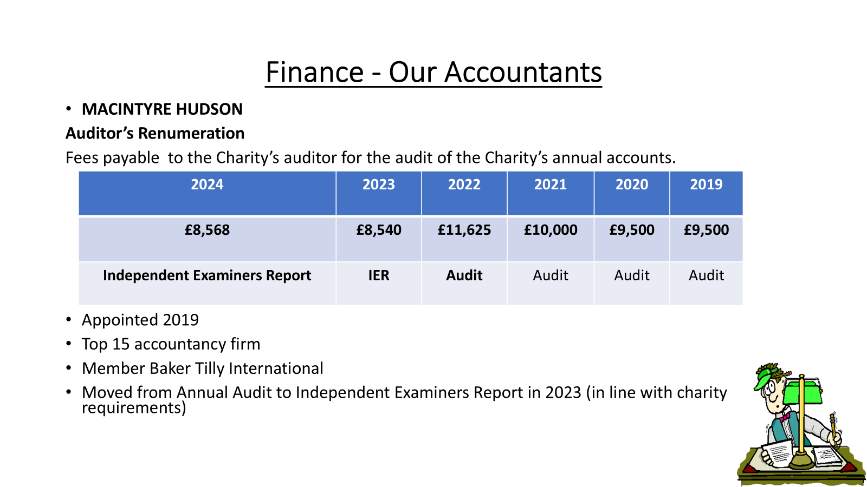

Slide 7
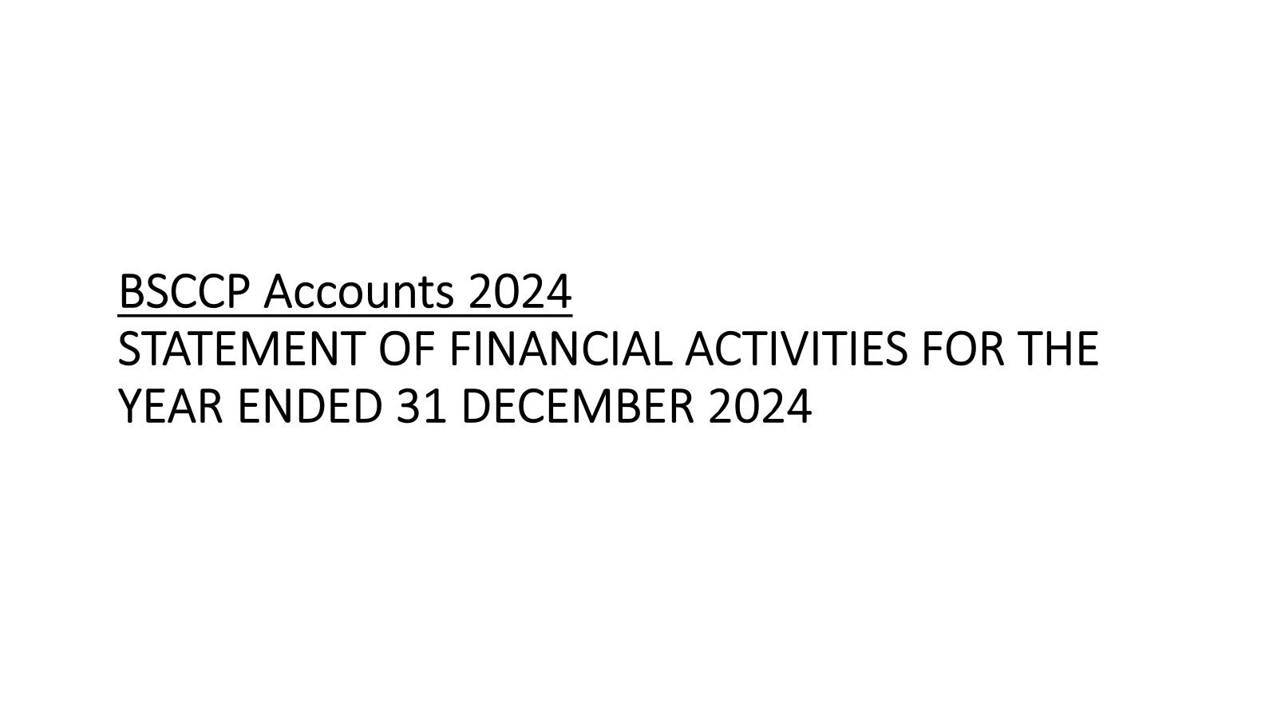

Slide 8
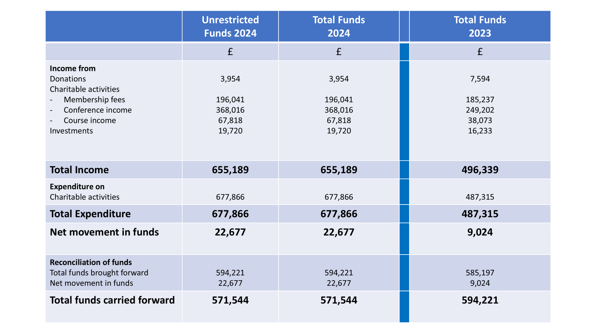

Slide 9
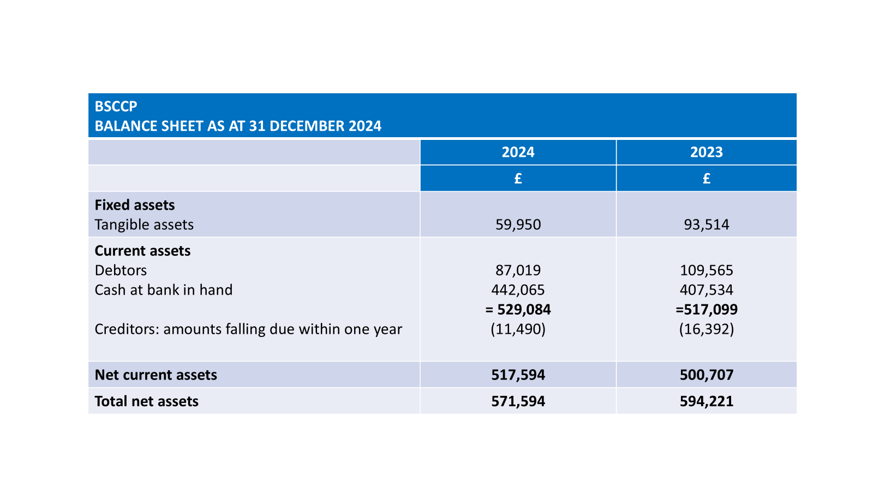

Slide 10
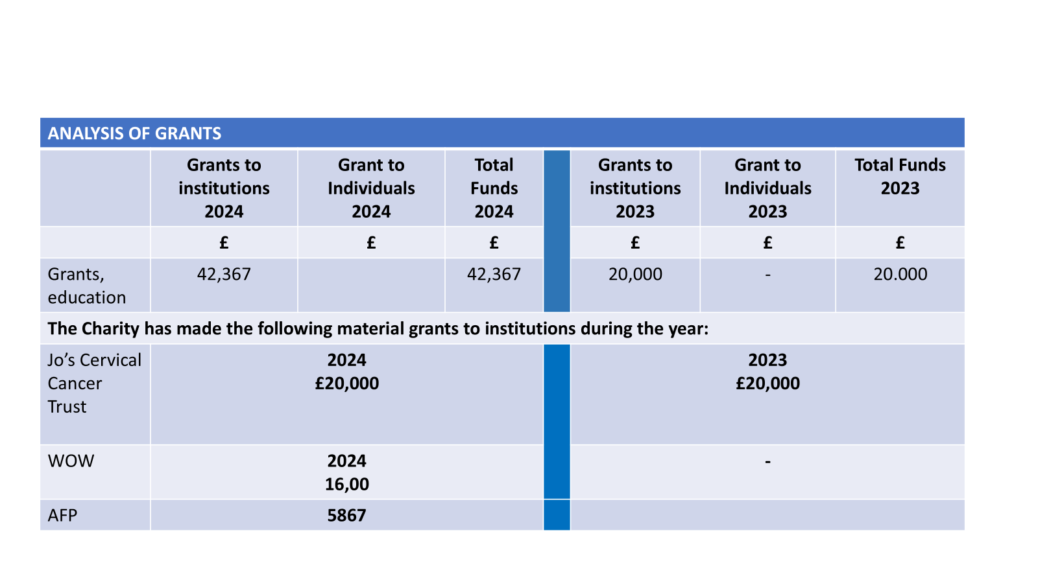

Slide 11
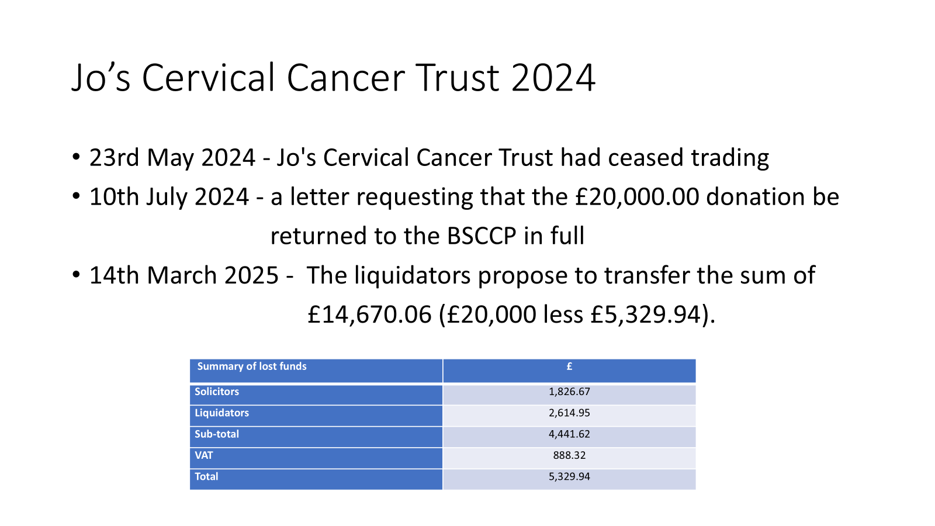

Slide 12
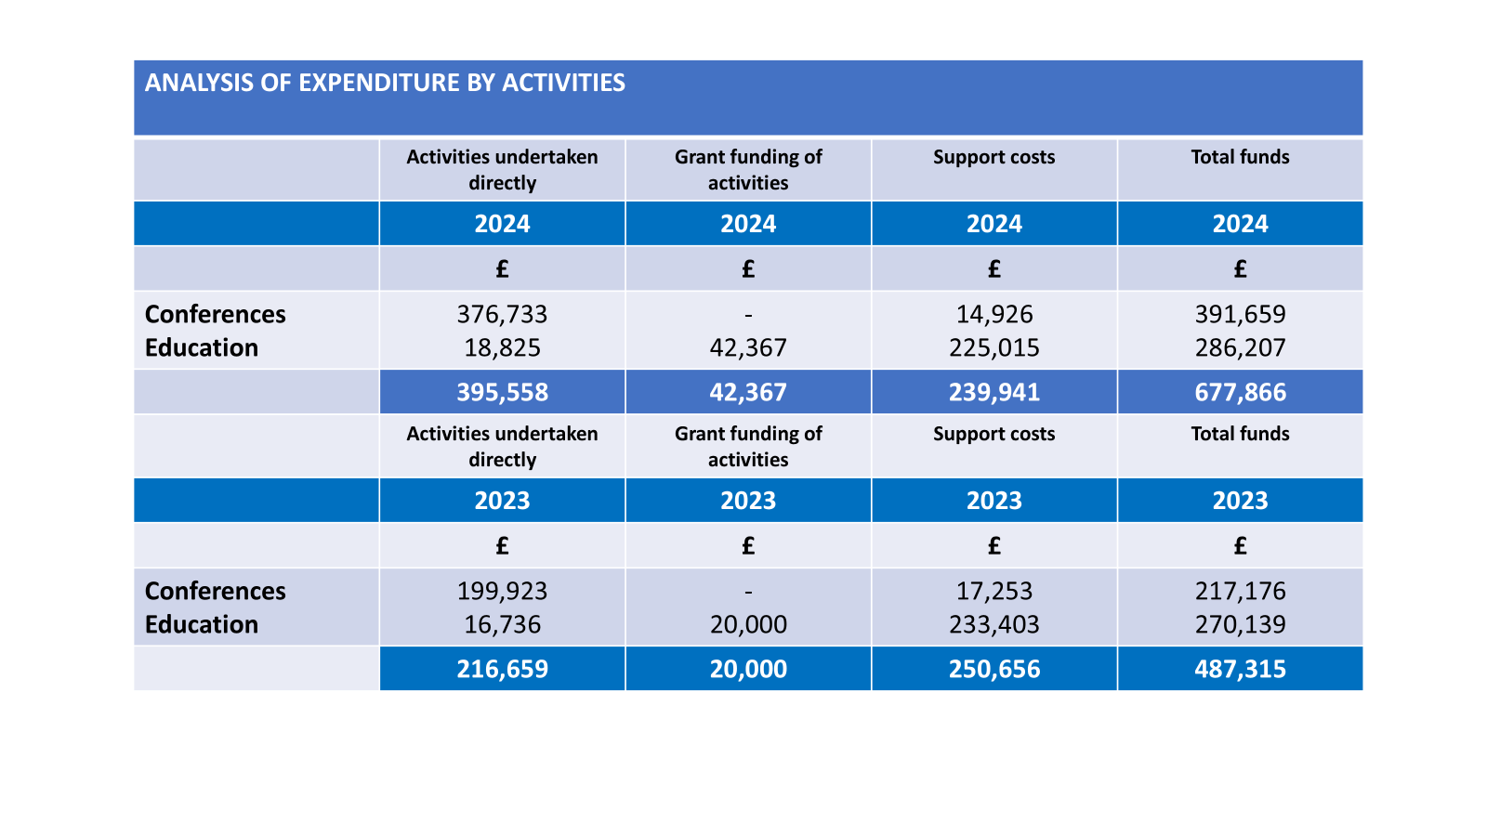

Slide 13
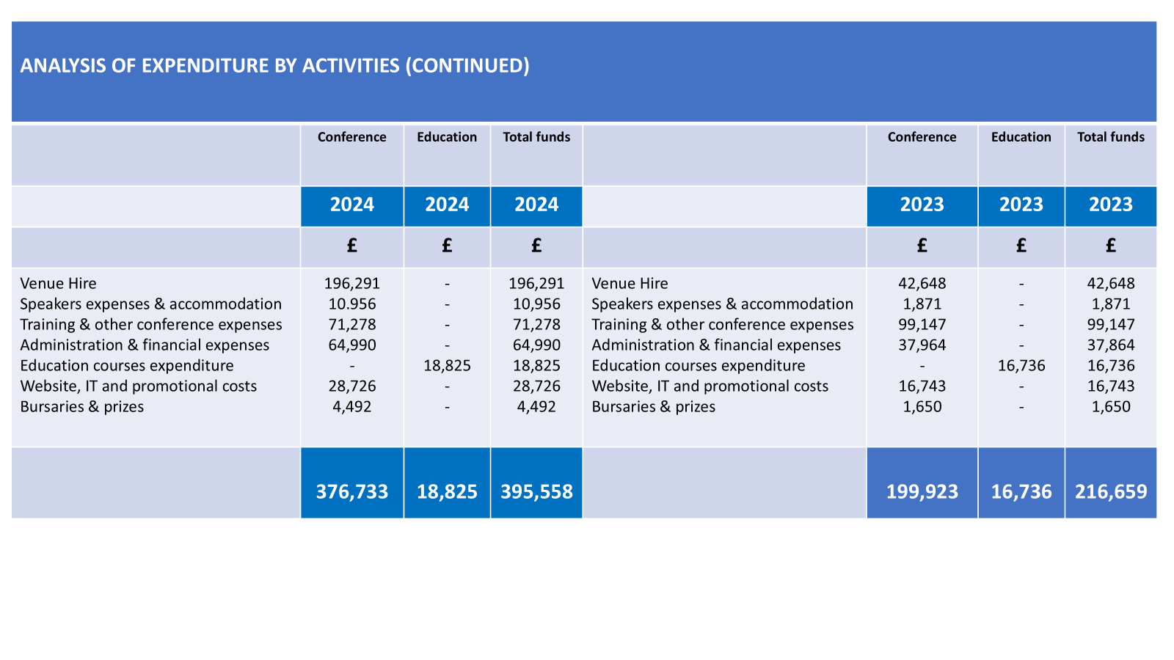

Slide 14
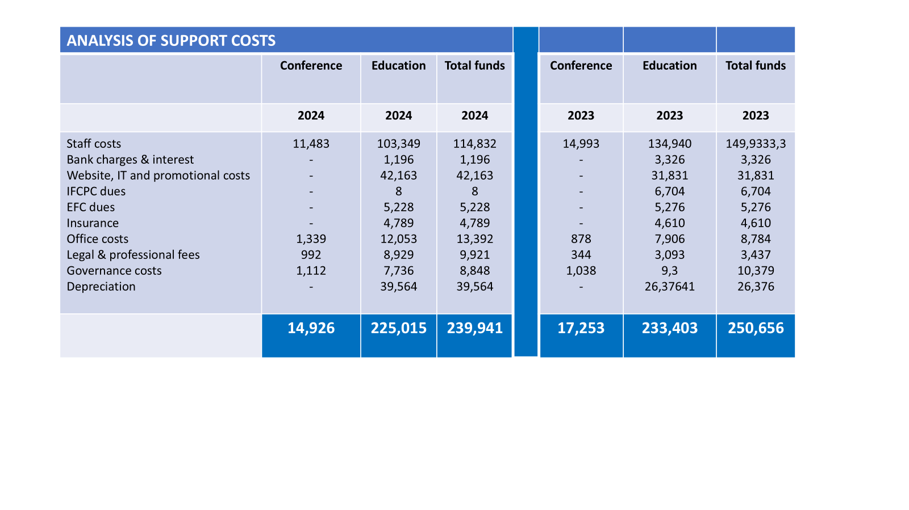

Slide 15
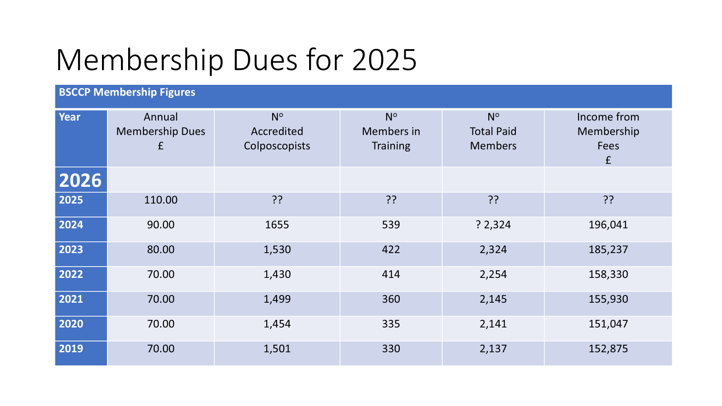

Slide 16
Honorary Secretary’s Report 2024
Deirdre Lyons / Jenni Byrom

Slide 17
Certification & Training Committee
2024 Exams & Courses
Online OSCE’s via OSLER Platform
Spring 2024 – 48 Candidates
Autumn 2024 – 48 Candidates
BSCCP Virtual OSCE Prep Courses
Spring 2024 – 32 Candidates
Autumn 2024 – 32 Candidates

Slide 18
Certification & Training Committee
2024 Courses
BSCCP Advanced course
15 November 2024 – Whittington Hospital London
BSCCP 2-day Basic Course
6/7 June 2024 – Whittington Hospital London
BSCCP Colposcopy Treatment Course
8 June 2024 – Whittington Hospital London

Slide 19
Certification & Training Committee
2024 Courses cont'd
NEPSEC Advanced Colposcopy Course
9th September 2024 – Wakefield
BSCCP/BAGP Basic Cervical Histopathology Course
26 June 2024 – half day virtual
Virtual South West Colposopy Study Day
21 June 2024 – full day

Slide 20
Certification & Training Committee
2025 Exams & Courses
Online OSCE’s via OSLER Platform
Spring 2025 – 70 Candidates
14/15 October 2025 – Registration will open for 48 Candidates
BSCCP Virtual OSCE Prep Courses
Spring 2025 – 32 Candidates
17 September 2025 – Registration will open for 32 Candidates

Slide 21
Certification & Training Committee
2025 Upcoming Exams & Courses cont'd
Cardiff/IBC Dubai ADVANCED Colposcopy Course - 2nd-3rd Nov 2025
Cardiff/IBC Dubai BASIC Colposcopy Course - 31st Oct-1st Nov 2025
Dublin BASIC Colposcopy Course 16th-17th Oct 2025
NEPSEC BASIC Colposcopy Course Wakefield 8th –10th Oct 2025

Slide 22
Certification & Training Committee
2026 Upcoming Exams & Courses
BAGP/ BSCCP Online histology course - 4th Feb 2026
BSCCP OSCE Preparation Course - 4th March 2026
BSCCP OSCE Exam - 21 - 22nd April 2026
BSCCP Annual Scientific Meeting Cork - 13th - 15th May 2026
Online cytology - TBC

Slide 23
Certification & Training Committee
BSCCP Colposcopist Re-accreditation 2024 -2027 Round opened on 01.09.2024
1655 Accredited Colposcopists
For colposcopists who haven't yet reaccredited the 12 month window will end on 31.08.2025. After this date it will be necessary to follow the "over 4 years pathway"
All information is available on the BSCCP website and BSCCP Learningzone

Slide 24
Membership as at 31/12/2024
•Members Total | 2230
•Certified Colposcopists | 1655
•In Training | 540
•New Trainees registered in 2024 | 210
•Nurses in Training | 70
•OSCE candidates in 2024 | 96
•Trainees passing OSCE in 2024 | 92
•OSCE failures in 2024 | 4
•Overall OSCE pass rate in 2024 | 96%
•Accredited Trainers | 470
•Accredited Nurse Colposcopists | 320

Slide 25
Awards and Scholarships
BSCCP Awards and Scholarships

Slide 26
Awards and Scholarships
2025 Oral and Poster Prizes
Up to two prizes of £150 each will be awarded for the best paper and oral presentations at the Sheffield 2025 Scientific Meeting.

Slide 27
Awards and Scholarships
Travel Bursaries 2025
Up to 10 bursaries of £150 to be awarded to members (trainee colposcopists and Nurse colpsocopsits) who submit the highest scoring abstracts.

Slide 28
Awards and Scholarships
2024 OSCE Prize
One prize of £150 to be awarded to the highest scoring OSCE exam candidate. The prize for the 2024 highest scoring OSCE Exam candidate is awarded to Imogen Wellman-Brown from Harrogate District and Foundation Trust.

Slide 29
Best Abstracts Travel Bursaries
Jennifer Davies
Sarah Hawco
Selina Chiu
Laura Ellis
Mukta Govil
Salamatu Abdul-Aziz
Ahmed Atik
Themistoklis Loukopoulos
Stephanie Baker
Shailaja Anipindi

Slide 30
Awards and Scholarships
Overseas Travel Bursary 2024
Dr Serrano Gustavo Ray from Columbia was awarded the BSCCP overseas travel bursary in 2024 and completed his training at Ninewells Hospital, Dundee. The Bursary is available up to the value of £5000.

Slide 31
Awards and Scholarships
Wellbeing for Women – BSCCP
Wow-BSCCP Postdoctoral Reseach Fellowships
2024
BSCCP £16,500 + Wow Matched funding £15,000
2025
BSCCP £16,500 + Wow Matched funding £15,000

Slide 32
IT Update
In April 2023 the Society implemented a new IT infrastructure
Modern Content Management System to provide information on the workings of the society as well as information for the wider public
The administration of the Colposcopy Training Programme, Colposcopy re-accreditation and Trainer certification and re-certification has been moved to a new Totara based Learning Management System

Slide 33
Objects of the BSCCP Charitable Incorporated Organisation
For the public benefit to protect and promote the health of the public, in particular (but without limitation) by:
promoting research and the dissemination of the useful results
the training and education of professionals in relation to the nature, causes, diagnosis, prevention, treatment and cure of cancers of the cervix and lower genital tract and
by providing information and raising public understanding of such matters.

Slide 34
Business of the President
Deirdre Lyons

Slide 35
Feedback from National Screening Programmes
England
Scotland
Wales
Northern Ireland
Republic of Ireland

Slide 36
EFC and IFCPC Updates
International Society Membership Fees
EFC Dues – European Federation for Colposcopy
£5228 was awarded for 2024 dues.
IFCPC Dues – International Federation for Cervical Pathology & Colposcopy
A payment of £5868 was awarded for 2024 dues.

Slide 37
BSCCP Committee Member Appointments 2025 -2028
Executive Committee Appointments updates:
North-West Representative – Helen Bradshaw
South-East Representative – Sapna Shah
South-West Representative – Ahmar Shah
Midlands Representative – Archie Krishna
IT Chair – Interim Grainne Flannelly

Slide 38
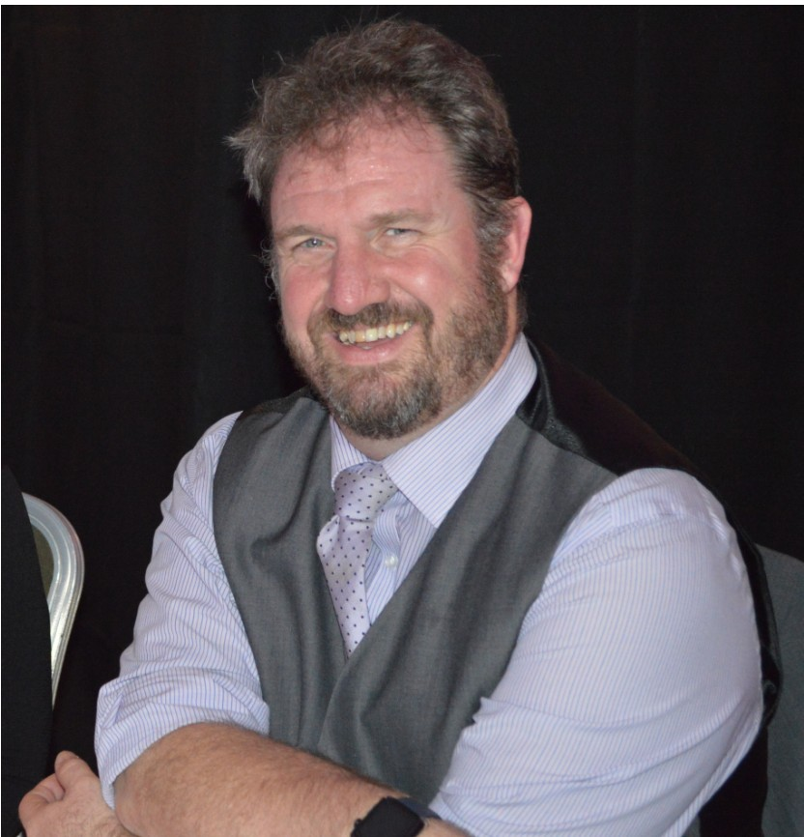
In memory of Mark Dunderdale
Mark was a consultant gynaecologist working at Walsgrave Hospital, Coventry.
He was the colposcopy lead for the service there and was involved with the QA regionally and nationally.
Mark was passionate about colposcopy and standards within the speciality.
He was BSCCP Regional representative on BSCCP Executive
He was the clinical QA lead for East of England
He achieved this through his teaching and training. He was committed to the BSCCP and was the West Midlands regional representative.
He was a regular examiner for the OSCE, rarely missing an exam

Slide 39
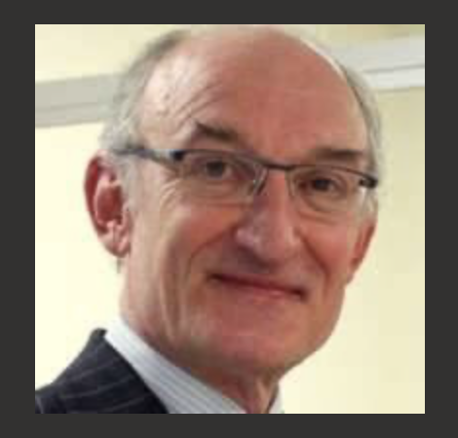
In Memory – Charles Redman
Charles – Gynaecological Oncologist Stoke-on-Trent
Past president EFC
Excellent teacher and Mentor
Committed to Teaching/ Training and Quality Assurance
Widely published especially in terms of Colposcopy

Slide 40

In memory of Ronald Jones
New Zealand Obstetrician and Gynaecologist
Known for work on cervical cancer
Advocacy for patient centred care
Awarded AAAS Scientific Freedom and Responsibility Award

Slide 41
Future Meetings including AGM
Deirdre Lyons

Slide 42
Future Meetings
BSCCP Scientific Meeting 2026 Cork
Clayton Silver Springs Hotel – 13th-15th May 2026

Slide 43
Any other Business

Slide 44

BSCCP AGM 2025 SHEFFIELD

